Slide 1
Interfacing ESP-32 and web server storage
BY:- Group-4
Dixaben shah

Slide 2
contents
Web server?
Functionality
How data is stored?
Block Diagram
References

Slide 3
Web server ?
The main function of web server use to store, process and deliver web pages to clients.
Web server includes web space that allows to upload file information like HTML files, image files on world wide web where it will be available at the global scale
Many web server supports side scripting using active server pages (ASP, PHP, hyper text preprocessor), or other scripting languages

Slide 4
Functionality
Web server software is access through domain names of websites and allows the delivery of site’s content to the requesting users.
On the software side web server includes server parts that control how web users access hosted files.
A HTTP server is a software that understands URLs ( web addresses) and HTTP (the protocol that your browser uses to view web pages)

Slide 5
HOW DATA IS STORED?
A database named tsolsystem is created by giving URL WWW.tsolsystem.com
These database is created by using SQL(structure query language) and PHP coding
When the motion is detected by PIR sensor , LPC2148 will give command to esp32 Cam to capture the image
The PHP script is responsible for receiving incoming images from esp32 cam , rename images with time stamp and store them in uploads folder

Slide 6
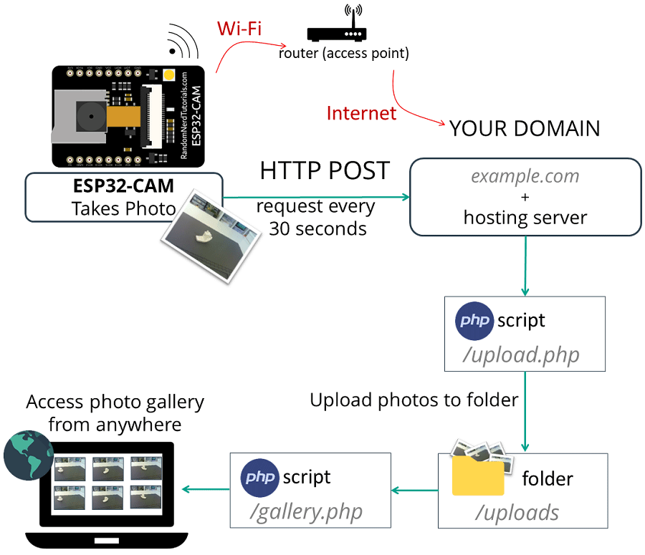
Block diagram

Slide 7
references
ESP32-CAM HTTP POST. Retrieved from:https://randomnerdtutorials.com/esp32-cam-http-post-php-arduino
WEB SERVER. Retrieved from:https://whatis.techtarget.com/definition/Web-server
Displaying Web Pages on the internet. Retrieved from:https://study.com/academy/lesson/how-data-is-displayed-on-the-internet

